Slide 1
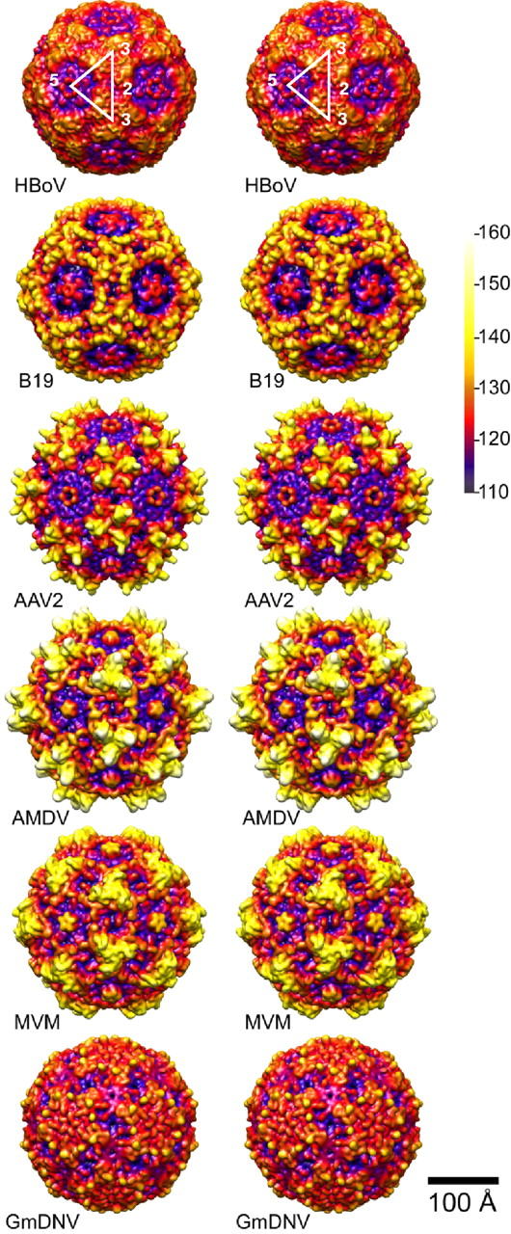
I
II
III
MVM - Parvovirus
GmDNV- Densovirus
B19V - Erythrovirus
3f
5f
2f
3f
Notes:
Surface topology groups among members of the Parvoviridae family. Stereo, depth cued (blue-red-yellow-white) capsid surface illustration of representative members of the two subfamilies of the parvoviruses. The virus and the genus to which it belongs are indicated. A viral asymmetric unit bound (white triangle) is shown by a 2-fold (2f), two 3-folds (3f) and a 5-fold (5f) axis on the GmDNV image. A horizontal scale bar (100 Å) for diameter measurement and a vertical color bar depicting color cueing as a function of particle radius in Å are shown on the right hand side. These images were computed from atomic coordinates using the UCSF-Chimera program (ref), and all are rendered at the same resolution (7.9 A) and magnification. The figure was adapted from (ref.).

Slide 2
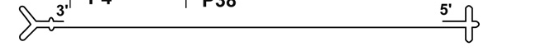
A
P4
P38
3’
NS1 / NS2
VP1 / VP2
5’
Non-structural ORF
Structural ORF
0
kb
1
2
3
4
5
5.1
0
m. u.
25
50
75
100
B
Transcripts
Proteins
kDa
D1
A2
D2
A1
R1 M, m, r
AAAAA
NS1
3
83
large intron
small intron
R2 M
3
2
2
AAAAA
NS2^{P}
25
R2 m
2
AAAAA
NS2^{Y}
3
25
R2 r
3
2
2
AAAAA
NS2^{L}
25
VP1u
capsid shell
R3 m
3
AAAAA
VP1
1
83
ORFs
R3 M, r
1
AAAAA
VP2
1
64
2
3
R2 M, m, r
AAAAA
SAT
2
6
poly(G)

Slide 3
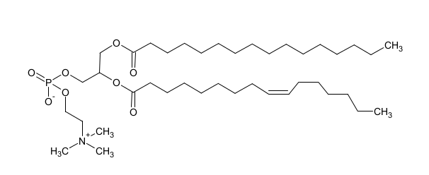

Slide 4
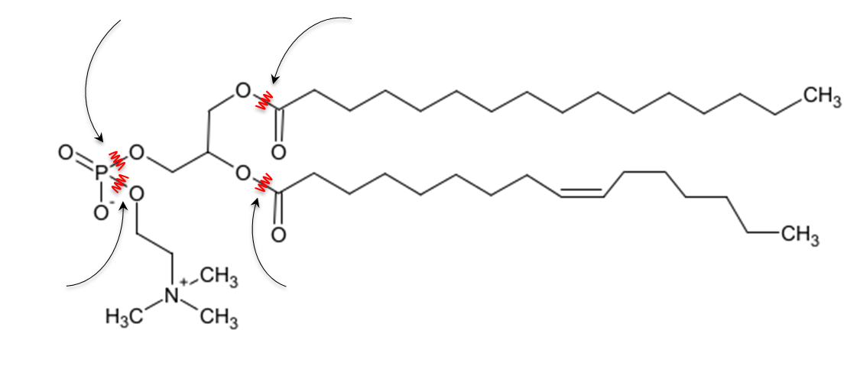
Phospholipase C
Phospholipase A₁
sn-1
sn-2
sn-3
Phospholipase D
Phospholipase A₂

Slide 5
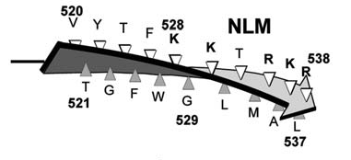
BC1
BC2
BC3
BC4
6
10
87
90
109
115
126
130
MVMp
H1-PV
CPV/FPV
MEV
PPV
BPV
AMDV
AAV
Ad
SV40
Py
ΦX174 (Protein J)
KRAKRG
KRAKRG
KRARRG
KRARRG
KRARGL
KKANSKK
KRAR
KR-K
KR-K
RTKR
RTKR
RAKK
RDKK
RAKR
QIKK
AKKR
RAGKRTR
RPGKRTK
KPTKRSK
KPTKRSK
RSPRKHP
RALKRKL
YPGKKRS
APGKKRP
KGKKRSG
---PP----A—YIFINQA
---PP----A--HIFVNQA
---PP-----P-HIFINLA
---PP-----P-HIFINLA
GSKPPGKRPAPRHIFINLA
YF-------ARSNKG---A
---------APRHVFIQQA
VEHSPVEP GTGKAGQQPA
RPGRPQ-PLR-GTKG----
RAKKK
RAKKK
KKKKA
KKKKA
KKKAK
KKANR
KKKKQ
RKRLN
KRKGARL
(x)₄
VP1u
A
NLM
βI
B
MVMp T Y G T F F W K G K L T M R A K L R – A N T T W
H1-PV T Y S T F Y W K G I L K F K A K L R – P N L T W
RPV T Y S D F W W K G K L V F K A K L R – A S H T W
CPV/FPV T Y S D F W W K G K L V F K A K L R – A S H T W
MEV T Y S D F W W K G K L V F K A K L R – A S H T W
AMDV T Y G Y F T W R G K L V L K G K L S – Q V T C W
PPV T Y S N F W W K G T L T F T A K M R – S S N M W
B19V Q Y A V G I M T V T M T F K L G P R K A T G R W
AAV Q Y S T G Q V S V E I E W E L Q – K E N S K R W
BPV I Y V T G Q V S C E V V W E V E – K R G T K N W

